Slide 1
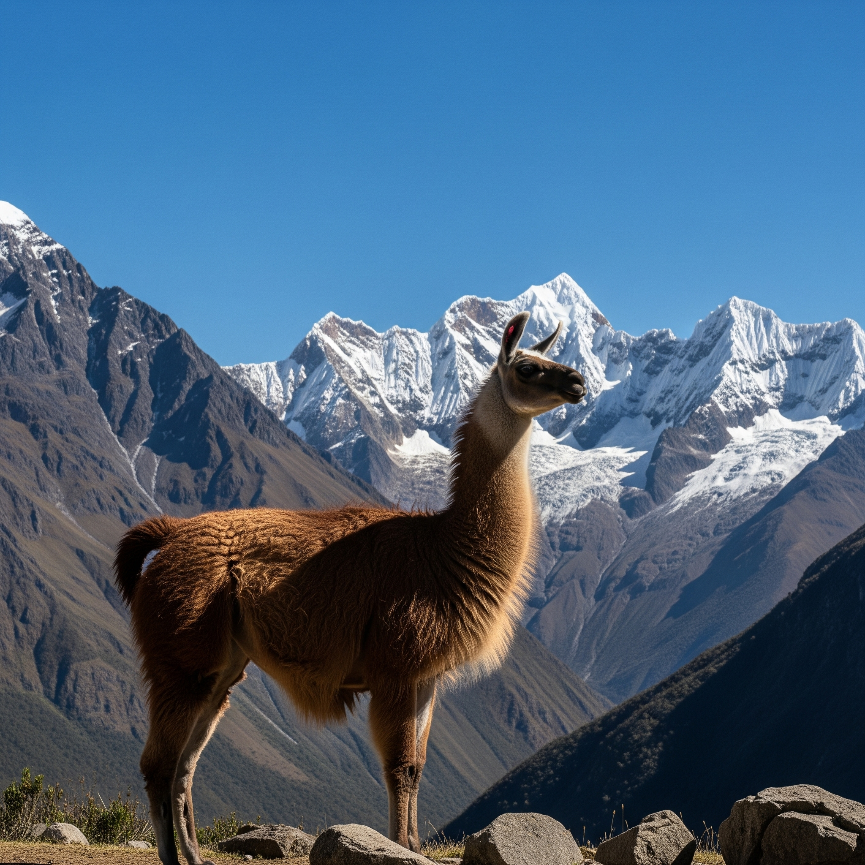
Llamas: Fascinating Animals of the Andes
An Overview of Their Life, Behavior, and Role
Notes:
Welcome everyone! Today, we're going to explore the fascinating world of llamas, unique animals deeply intertwined with human history and culture in the Andes Mountains of South America. Let's discover why they're so remarkable.

Slide 2
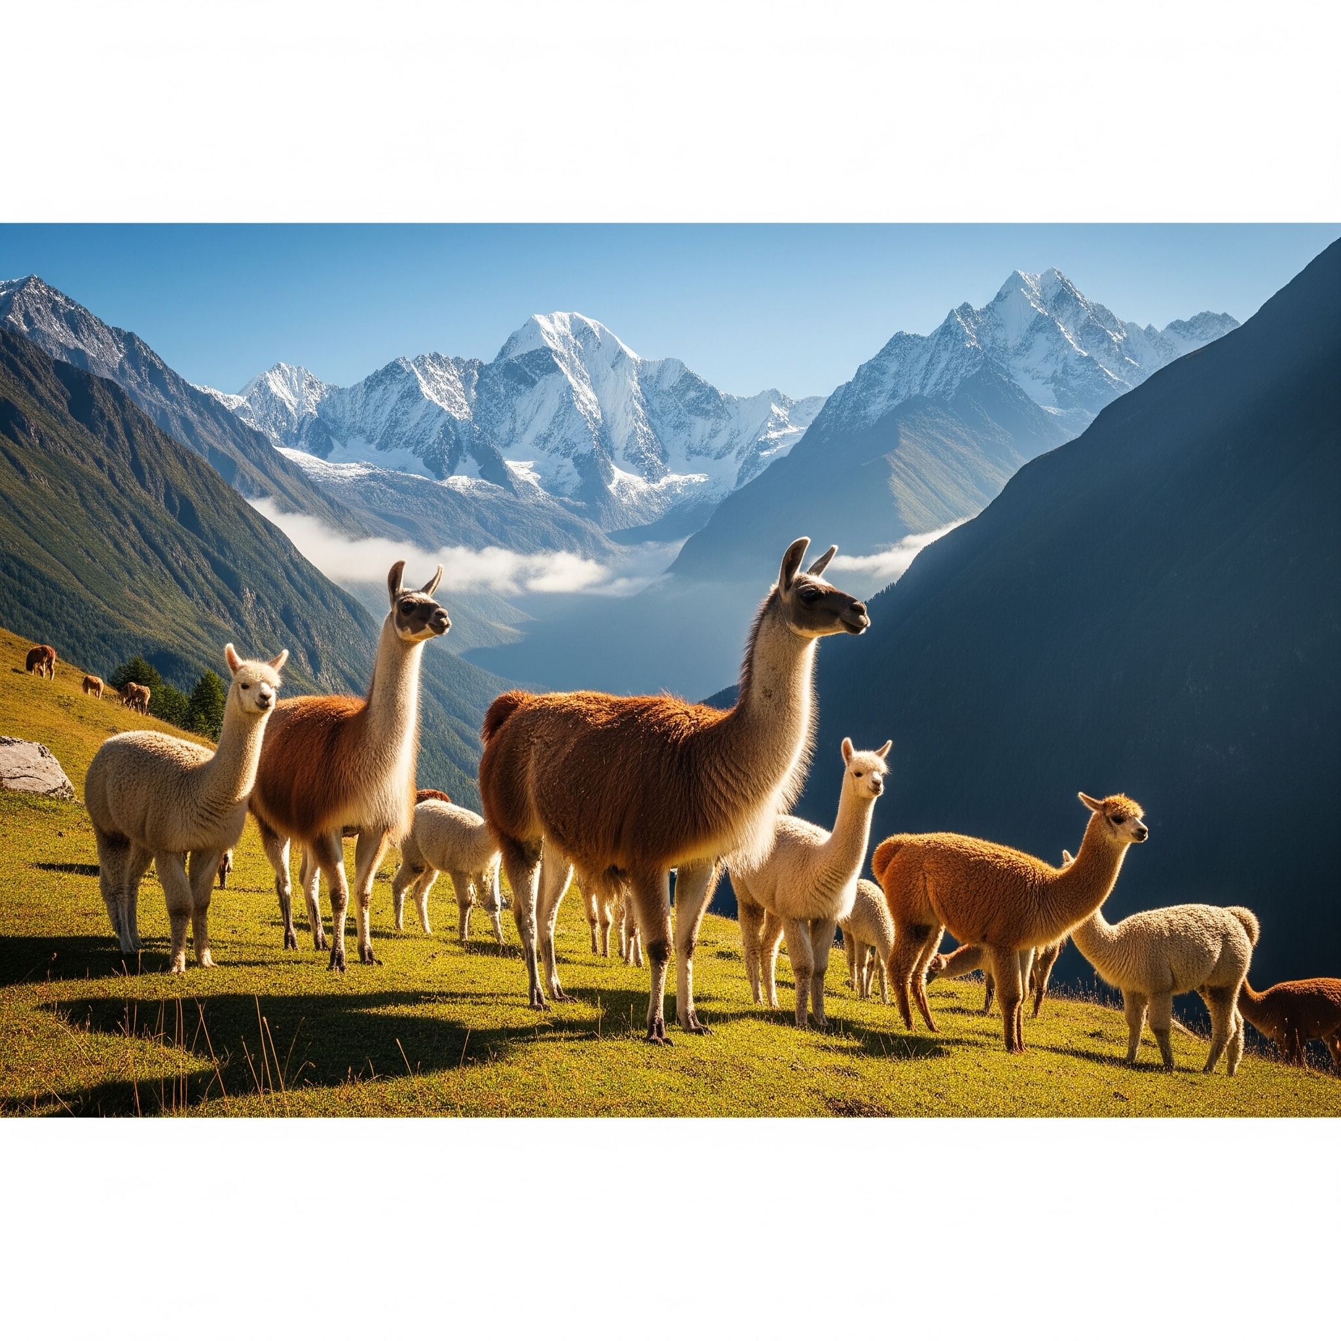
Introduction to Llamas
Definition: A domesticated South American camelid.
Scientific Name: Lama glama.
Origin: Andes Mountains, South America.
Related Species: Alpacas, Guanacos, Vicuñas (wild relatives).
Notes:
Llamas were domesticated thousands of years ago. They descend from wild camelids native to South America and share their habitat with related species like alpacas, guanacos, and vicuñas.

Slide 3
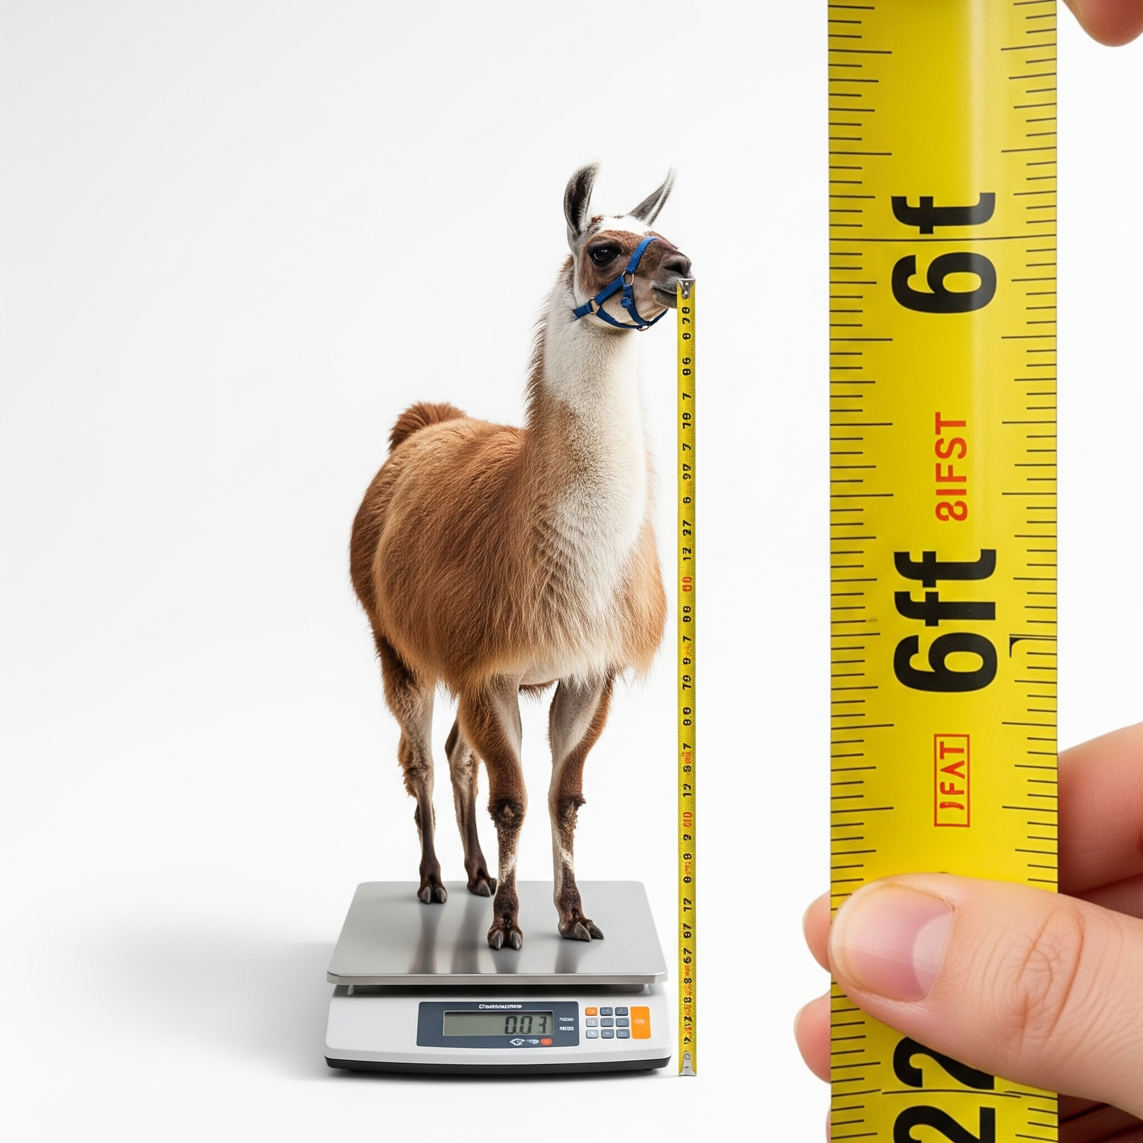
Physical Characteristics
Height: ~5.5 to 6 feet tall at the head.
Weight: 280-450 pounds (127-204 kg).
Coat: Soft, woolly fiber available in various colors.
Adaptations: Large lungs, efficient oxygen use at high altitudes.
Notes:
Llamas are well adapted to life in harsh mountain environments, with thick coats protecting them from the cold and specialized respiratory adaptations that allow survival at high elevations.

Slide 4
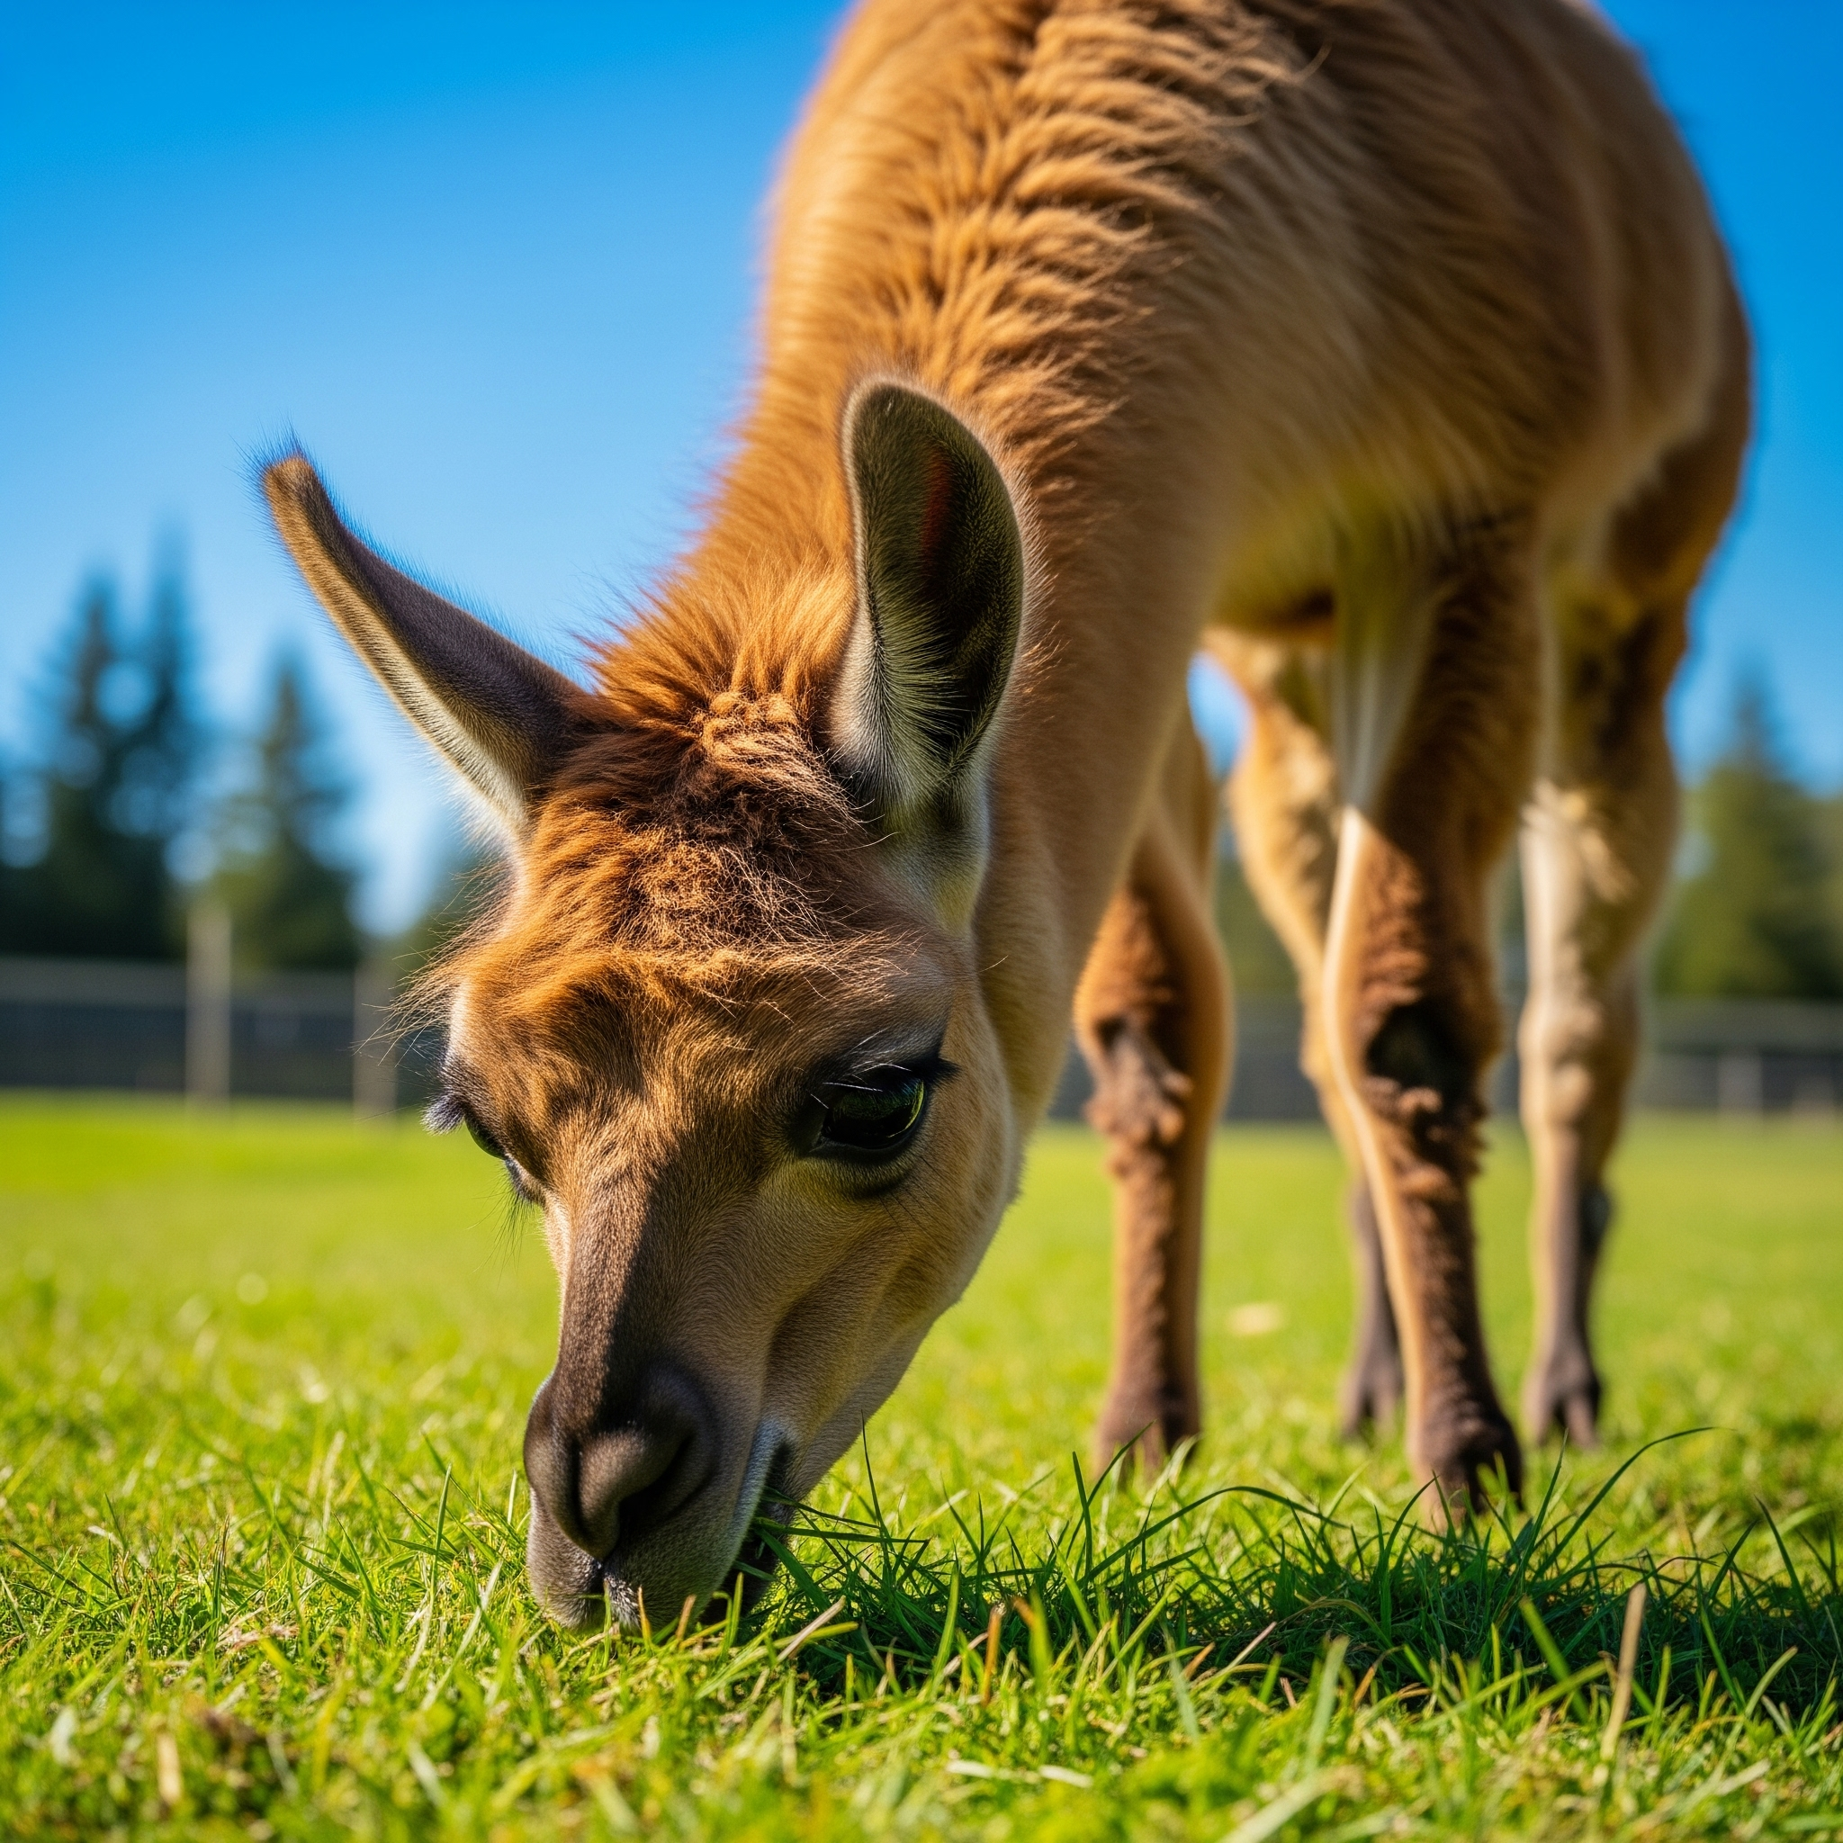
Diet & Habitat
Diet: Herbivorous; grasses, hay, grains, leaves.
Habitat: Semi-arid regions, high-altitude grasslands (Altiplano).
Water Needs: Require regular access to clean water.
Notes:
Llamas have a simple but nutritious diet. Their feeding habits make them ideal animals for regions where food can be sparse, demonstrating their adaptability.

Slide 5
Behavior & Social Structure
Social Nature: Highly social herd animals.
Communication: Use humming, ear positioning, body language.
Defensive Behavior: Spitting when threatened or stressed.
Hygiene Habits: Create communal dung piles.
Notes:
Llamas have a sophisticated social structure. They communicate effectively through subtle signals and body language. Contrary to popular belief, llamas only spit as a last resort when feeling threatened or irritated.

Slide 6
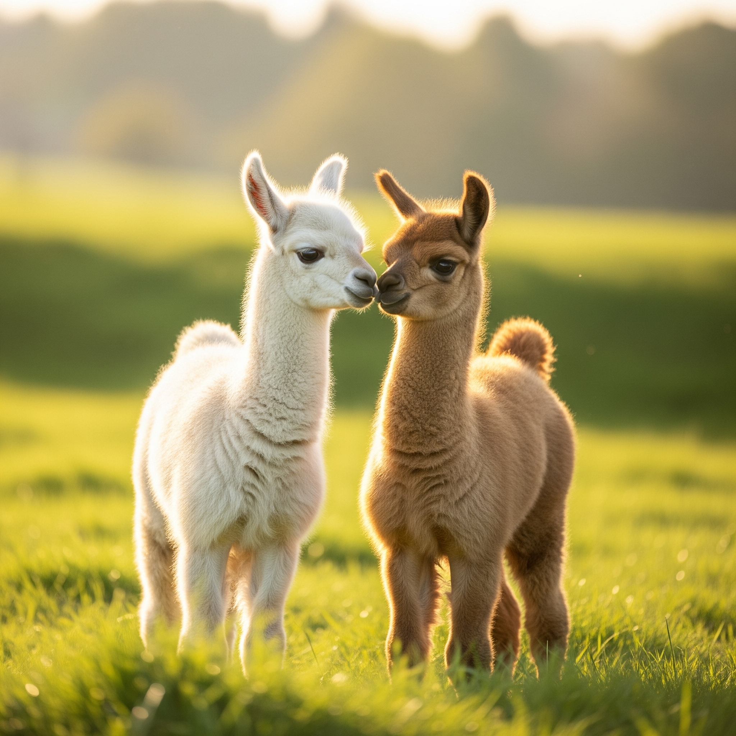
Breeding & Life Cycle
Gestation: Approximately 11.5 months.
Cria: Name given to newborn llamas.
Early Life: Standing and nursing shortly after birth.
Lifespan: Typically 15-25 years.
Notes:
Llamas have a relatively long gestation period, producing typically one offspring (cria) per year. Newborn llamas are quick to stand and nurse, vital for survival in challenging environments.

Slide 7
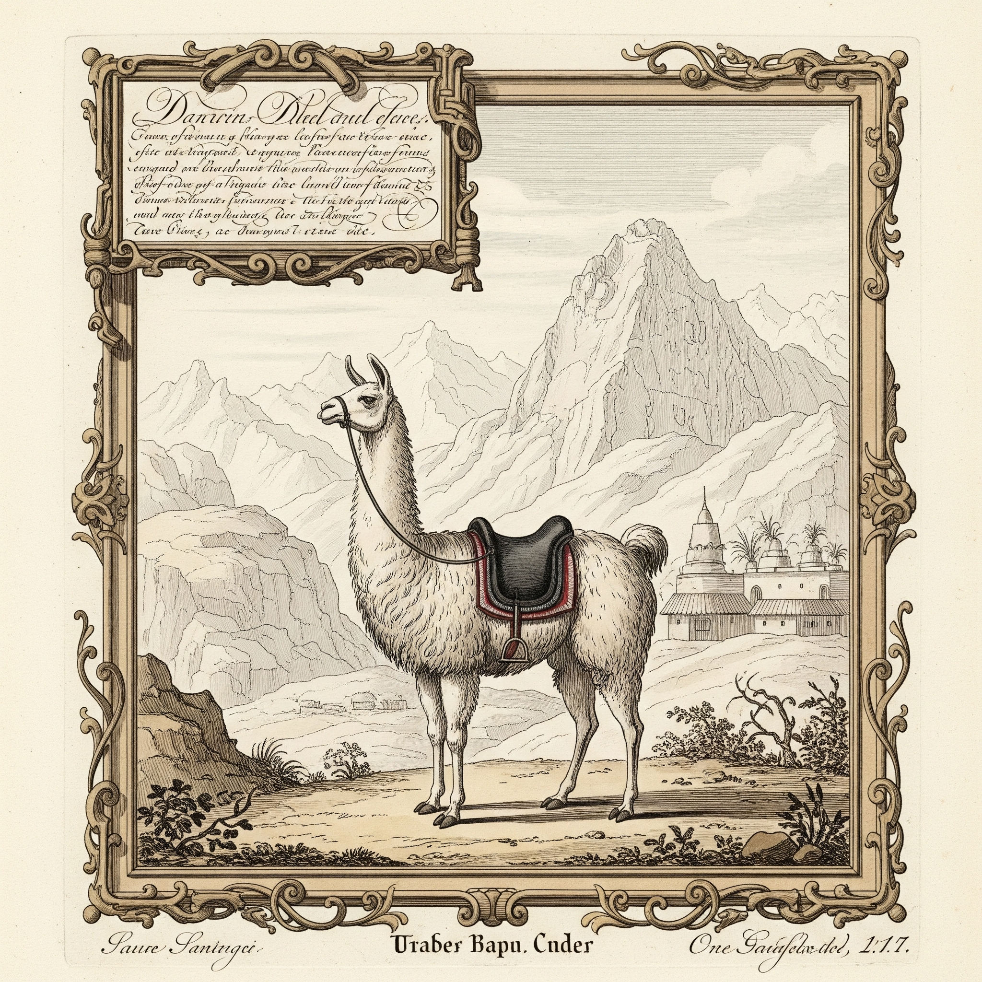
Historical & Cultural Significance
Domestication: Occurred 4,000-5,000 years ago.
Uses Historically: Transport, wool, food, rituals.
Cultural Role: Symbolic importance in Andean cultures.
Notes:
Llamas have been integral to the Andean way of life for thousands of years. They were central to trade, transportation, clothing production, and had spiritual significance to indigenous communities.

Slide 8
Modern Uses of Llamas
Fiber Production: High-quality wool for textiles.
Pack Animals: Popular in hiking and trekking tourism.
Therapy Animals: Gentle temperament makes them suitable.
Guard Animals: Effective protectors of sheep and goats from predators.
Notes:
Today, llamas have diversified roles. Their gentle nature makes them beloved as therapy animals, while their strength and wool continue to make them economically valuable in various industries.

Slide 9
Conservation & Welfare
Conservation: Focus on wild relatives like guanacos, vicuñas.
Threats: Habitat loss, climate change impact ecosystems.
Ethical Care: Importance of proper shearing, humane living conditions, veterinary care.
Notes:
Although domesticated llamas are not endangered, ethical farming practices are crucial. Conservation efforts focus mainly on wild camelids threatened by human activities and environmental changes.

Slide 10
Conclusion & Fun Facts
Intelligent & Curious: Highly trainable and inquisitive.
Strength: Can carry approximately 25-30% of their body weight.
Community Impact: Sustainable farming supports local economies and ecosystems.
Notes:
To wrap up, llamas are extraordinary animals, intelligent, strong, and culturally significant. By supporting responsible llama farming, we contribute positively to local economies and ecosystems. Thank you, and I’d be happy to answer any questions!

